Slide 1
Deeper Insights into Graph Convolutional Networks for Semi-Supervised Learning
Qimai Li, Zhichao Han, Xiao-Ming Wu
Department of Computing
The Hong Kong Polytechnic University

Slide 2
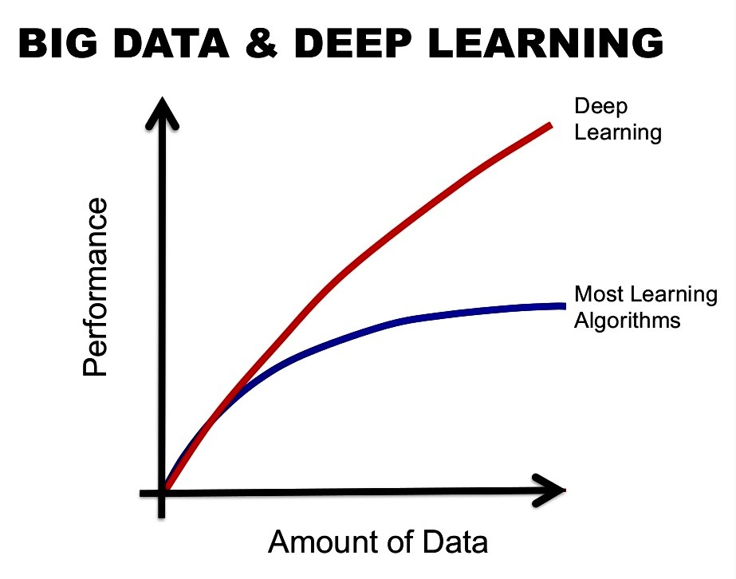
Supervised Learning
Tons of labeled data
A good model
Image via “https://www.linkedin.com/pulse/deep-learning-aviation-francis-j-duque”
Notes:
Deep learning and Neural network based models has clear advantages over traditional machine learning algorithms., This added flexibility and power comes at the cost of requiring more training data, often a lot more data, which is a big challenge. It is well known that deep learning needs a lot of training data to tune a huge number of parameters. Neural network based models has a lot of meta parameters to tune. And very computationally expensive.

Slide 3
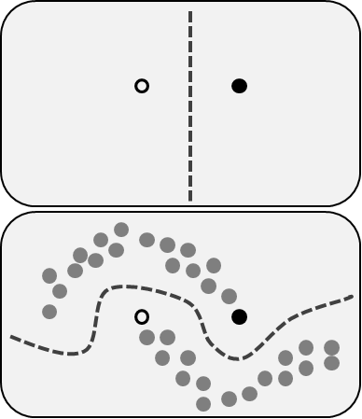
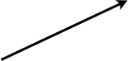
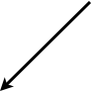
Semi-Supervised Learning (SSL)
How unlabeled data helps?
Decision
Boundary
Better
Decision
Boundary
Image via “https://en.wikipedia.org/wiki/Semi-supervised_learning”
Notes:
Semi-supervised learning is interesting because it uses large amount of unlabeled data to help the supervised classification. It is well-known that the unlabeled data, when used properly, can significantly improve learning performance. An example of the influence of unlabeled data in semi-supervised learning. The top panel shows a decision boundary we might adopt after seeing only one positive (white circle) and one negative (black circle) example. The bottom panel shows a decision boundary we might adopt if, in addition to the two labeled examples, we were given a collection of unlabeled data (gray circles). This could be viewed as performing clustering and then labeli

Slide 4
How to Leverage Unlabeled Data
Node -> Document Edge -> Citation Link
Image via https://www.cwts.nl/media/images/content/b515d3b727bc41fe7e858df0ffd062bf_large.png
Notes:
The key challenge in SSL is how to leverage unlabeled data to improve learning performance. Let us take the problem of document classification in a citation network as an example. This picture shows a citation network where each node represents a document, and each document is represented by bag-of-words feature. The citation links between documents describe their citation relations. In this figure, different types of documents are indicated by different colors. In semi-supervised classification, only the class of some nodes is given, and the goal is to classify the other nodes. To classify the documents, we need to jointly model the feature information and the graph structure.
In many applications, data instances come
with feature vectors containing information not present in
the graph. For example, in a citation network, the citation
links between documents describe their citation relations,
while the documents are represented as bag-of-words vectors
which describe their contents. Many semi-supervised
learning methods seek to jointly model the graph structure
and feature attributes of data.

Slide 5
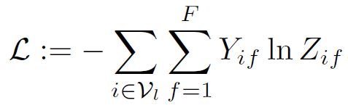

Graph Convolutional Networks
(Kipf & Welling, ICLR, 2017)
Layer-wise propagation rule:
$$H^{\left(l+1\right)}=σ\left(AH^{\left(l\right)}Θ^{\left(l\right)}\right)$$
GCNs for semi-supervised classification:
$$Z=softmax\left(Aσ\left( AXΘ^{\left(0\right)}\right)Θ^{\left(1\right)}\right)$$
Convolution layer: preprocessed
adjacency matrix
Projection layer: fully connected networks
Notes:
The recently proposed graph convolutional networks, is a very interesting framework for integrating network structure and node features. GCNs adopt a layer-wise propagation rule. Each layer of GCN contain a convolution layer and projection layer. The activation of the previous layer is denoted by H, with a superscript l, H(l) is left multiplied by a preprocess graph adjacency matrix, which is called the convolution filter. The filtered signals are then right multiplied by a trainable weight matrix, feed into a FCN which is a fully connected layer.
Clearly, the GCN model combines the graph structure and vertex information in the
The GCN model for SSL is by stacking two layers and applies a softmax classifier on the output features. The loss function is the cross entropy loss on the labeled data. The input of GCN is the feature matrix X, the adjacency matrix contrains graph information. The trainable parameters here is theta, the projection layer. GCN combine the graph and feature information in a very simple form. It turns out such a simple architecture achieved the best performance on the citation networks.

Slide 6
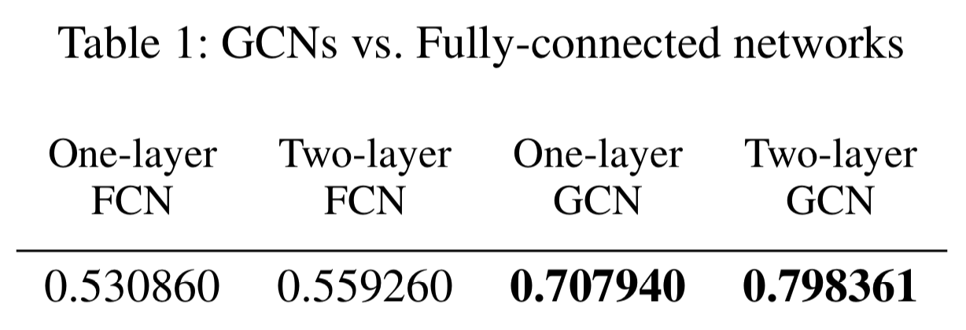
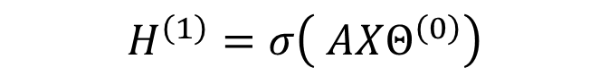
Why GCNs Work
$$H^{\left(1\right)}=σ\left( AXΘ^{\left(0\right)}\right)$$
Convolution layer: preprocessed
adjacency matrix
Projection layer: fully connected networks
Notes:
To understand the reasons why GCNs work so well, we compare them with the simplest fully-connected networks
(FCNs), where the layer-wise propagation rule is Clearly the only difference between a GCN and a FCN is the
graph convolution applied on the left of the feature matrix X. To see the impact of the
graph convolution, we tested the performances of GCNs and
FCNs for semi-supervised classification on the Cora citation
network with 20 labels in each class. The results can be
seen in Table 1. Surprisingly, even a one-layer GCN outperformed
a one-layer FCN by a very large margin. Stacking two layers, the performance of GCNs keepWe can also see from Table 1 that
while the 2-layer FCN only slightly improves over the 1-
layer FCN, the 2-layer GCN significantly improves over the
1-layer GCN by a large margin. This is because applying
smoothing again on the activations of the first layer makes
the output features of vertices in the same cluster more similar
and further eases the classification task.

Slide 7
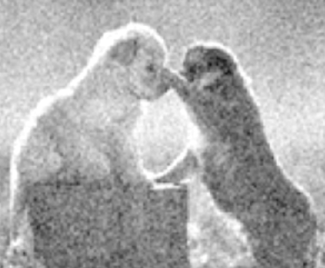
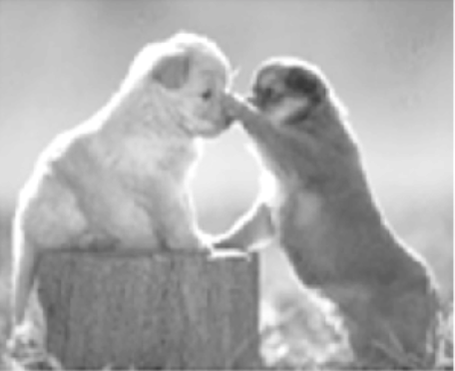
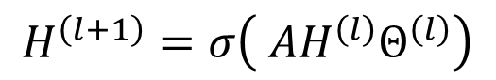
Laplacian Smoothing
$$H^{\left(l+1\right)}=σ\left( AH^{\left(l\right)}Θ^{\left(l\right)}\right)$$
Smoothing
Notes:
The graph convolution is a special form of Laplacian smoothing with symmetric
Laplacian smoothing..The Laplacian smoothing computes the new features of a
vertex as the weighted average of itself and its neighbors’.
Since vertices in the same cluster tend to be densely connected,
the smoothing makes their features similar, which
makes the subsequent classification task much easier. As we
can see from Table 1, applying the smoothing only once has
already led to a huge performance gain. This is similar to image processing, where the smoothing has the denoise effect. That is the reason why GCN works

Slide 8
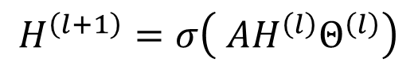
Limitations of GCNs (1)
$$H^{\left(l+1\right)}=σ\left( AH^{\left(l\right)}Θ^{\left(l\right)}\right)$$
Localized filter
Labeled instance
Unlabeled instance
Instance adjacent to a
labeled instance
Need to stack many layers to explore global graph topology when labeled data is few - overfitting
Notes:
The above analysis raises potential concerns about stacking
many convolutional layers in a GCN. Besides, a deep
GCN is much more difficult to train. In fact, the GCN used
in (Kipf andWelling 2017) is a 2-layer GCN. However, since
the graph convolution is a localized filter – a linear combination
of the feature vectors of adjacent neighbors, a shallow
GCN cannot sufficiently propagate the label information to
the entire graph with only a few labels. As shown in Fig. 1,
the performance of GCNs (with or without validation) drops
quickly as the training size shrinks. In fact, the accuracy of
GCNs decreases much faster than the accuracy of label propagation.
Since label propagation only uses the graph information
while GCNs utilize both structural and vertex features,
it reflects the inability of the GCN model in exploring
the global graph structure.

Slide 9
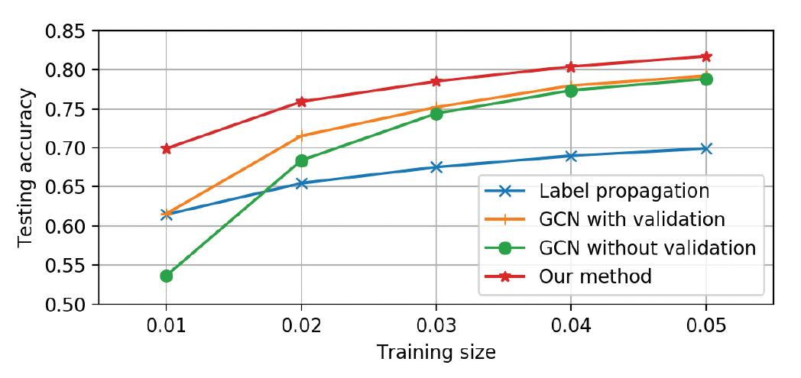
Limitations of GCNs (2)
Need additional labeled data for model selection
Notes:
Another problem with the GCN model in (Kipf and
Welling 2017) is that it requires an additional validation set
for early stopping in training, which is essentially using the
prediction accuracy on the validation set for model selection.
If we optimize a GCN on the training data without using the
validation set, it will have a significant drop in performance.
As shown in Fig. 1, the performance of the GCN without validation
drops much sharper than the GCN with validation. In
(Kipf and Welling 2017), the authors used an additional set
of 500 labeled data for validation, which is much more than
the total number of training data. This is certainly undesirable
as it defeats the purpose of semi-supervised learning.
Furthermore, it makes the comparison of GCNs with other
methods unfair as other methods such as label propagation
may not need the validation data at all

Slide 10
Our Solutions (1)
Co-train a GCN with a random walk model
Use random walks to explore global topology
Extend the labeled set with high-confidence predictions by the random walk model
Labeled instance
Unlabeled instance
Pseudo labeled instance
Notes:
To improve the performance of GCNs and overcome its limitations, we popose to
The idea is to co-train …
As random walk models are known to be able to capture the gloabal graph structure, which is complement to the local convolution filter. We add the high-confidence predictions by the random walk model to the training set. This greatly improve the performance of GCNs when the labeled data is very few, and the enlarged training set also exempt GCNs from requiring an additional validation data.

Slide 11
Our Solutions (2)
Self-training
Extend the labeled set with high-confidence predictions by a pre-trained GCN
Union of Self-training and Co-training
Add to the diversity of pseudo labels
Intersection of Self-training and Co-training
Get more accurate pseudo labels
Notes:
We also try

Slide 12
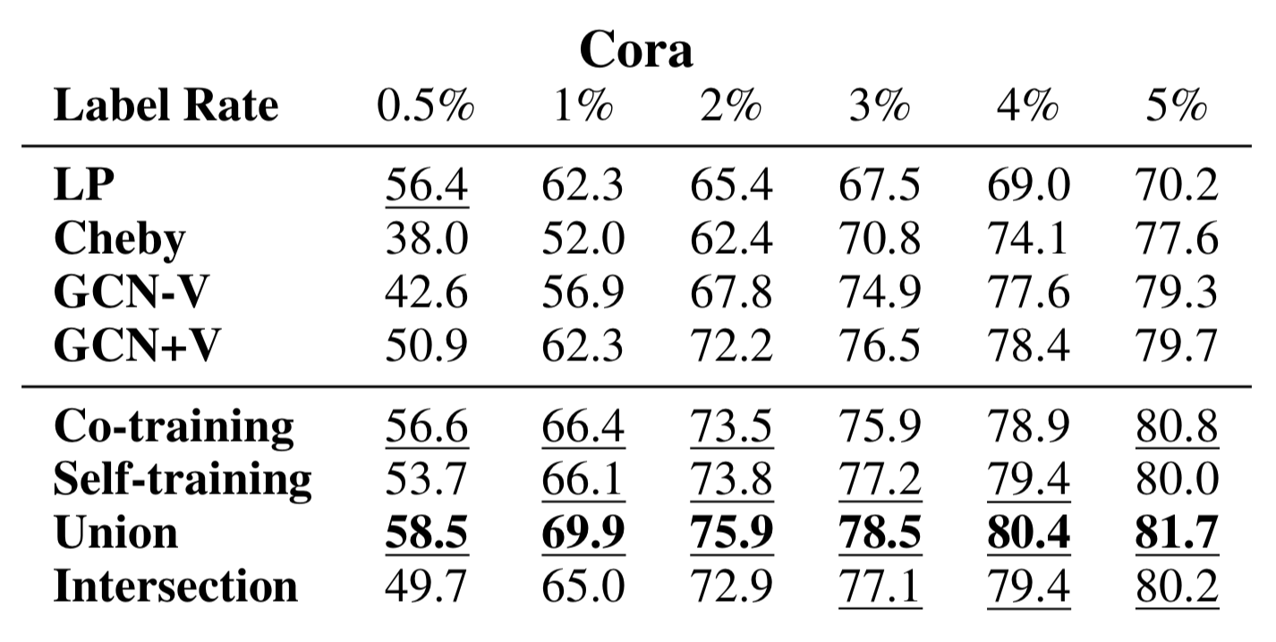
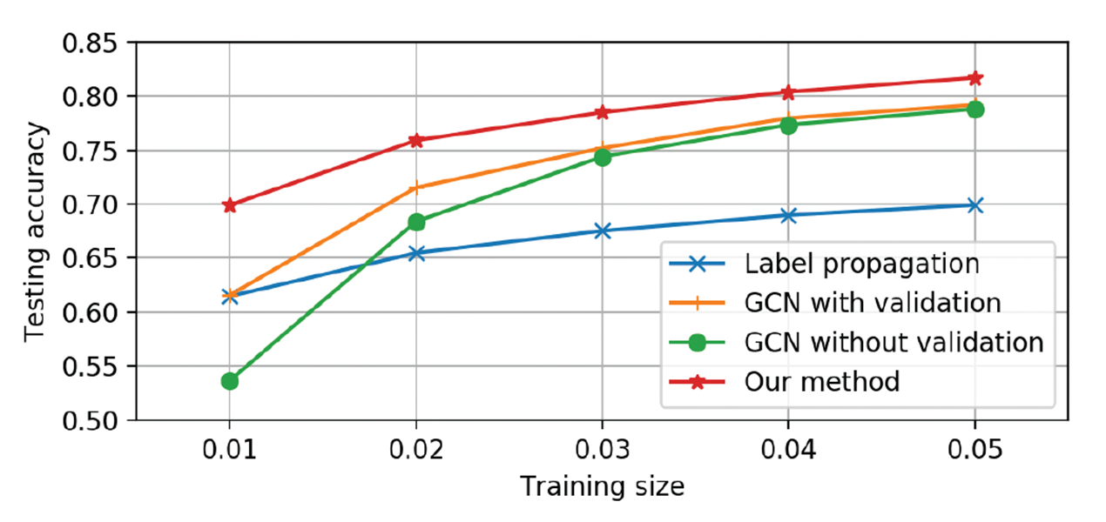
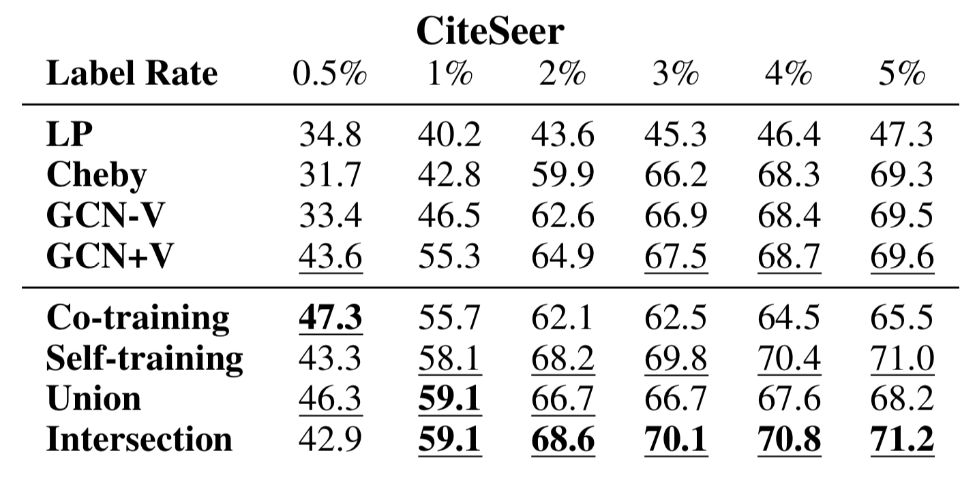
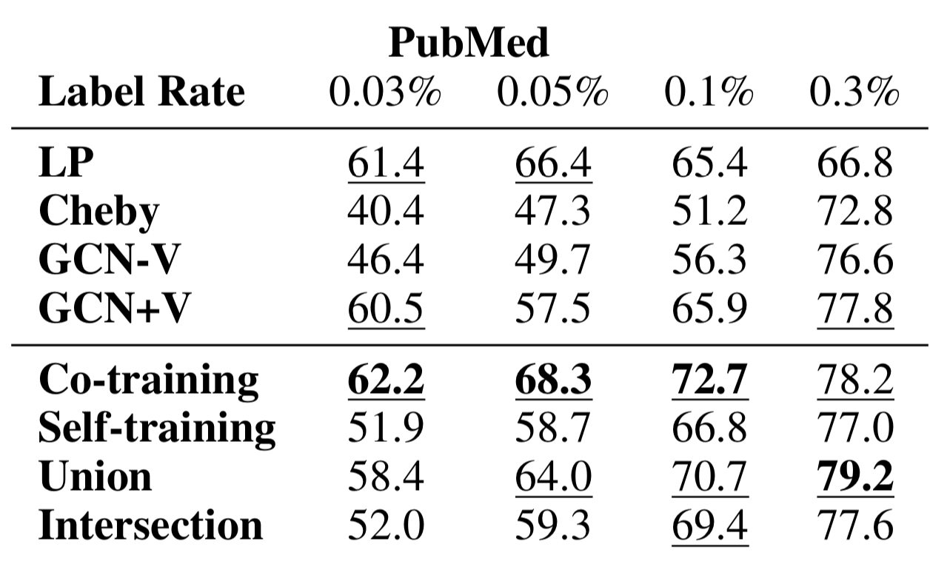
Experimental Results
Significant improvements on 3 citation networks
Notes:
Experiments on three benchmark citation networks. The results show signicant improvement over GCNs especially when the train size is small

Slide 13
Summary
Contributions
Principled understanding of the working mechanisms and limitations of GCNs for SSL
Solutions to improve GCNs
Future directions
Designing more powerful convolution filters
Techniques for training GCNs

